Slide 1

Project - II (210CS600)
Online GoodReads Store
Prepared By:
Harsh V. Mevada(21020201099)
Diploma Computer Engineering
Darshan Institute of Engg. & Tech. for Diploma Studies, Rajkot.
Guided By:
Prof. Asha A. Gondaliya
Computer Engineering Dept.,
Darshan Institute of Engg. & Tech. for Diploma Studies, Rajkot.

Slide 2
Overview
Abstract
Problem Summary
Module Description
Data Dictionary
Diagrams
Screenshot
Conclusion
Expected Outcomes
Thank You

Slide 3
Abstract
The “Online GoodReads” is a dynamic website, this website about read quotes there are so many types of quotes and in over website I are doing some different in this website I have add some functionalities to make dynamic website, user can login with their username and password, user can register to the website, user can view title ,content , likes ,comments and author’s name of quotes,user can like the quotes , user can post feedbacks , authenticated users can visit website there is the overview of the over project and website.

Slide 4
Problem Summary
Problem Identification
In a ticket management system, effectively identifying problems is crucial for efficient issue resolution. To achieve this, the process entails meticulous information gathering and articulation. Firstly, users need to provide a comprehensive description of the problem, including its nature, frequency, and impact. Specific details such as error messages, timestamps, and affected functionalities aid in pinpointing the root cause. Additionally, users should outline any steps they took before encountering the problem, aiding in recreating the issue for troubleshooting. Clear categorization of the problem based on predefined criteria streamlines the allocation to the appropriate support team. Regular updates and collaboration between users and support staff facilitate a deeper understanding of the problem, leading to quicker resolutions. In essence, accurate problem identification hinges on collaborative information exchange, detailed contextualization, and systematic categorization within the ticket management system.

Slide 5
Problem Summary
Problem Solution
The problem at hand involves enhancing the efficiency of a ticket management system. The current system is facing challenges in terms of effectively managing and resolving user-generated tickets and complaints. The solution entails implementing several key improvements. Firstly, a streamlined user interface will be developed, making it easier for users to submit their issues and provide detailed descriptions. Additionally, an automated categorization system will be integrated to classify incoming tickets accurately, enabling faster routing to the appropriate support teams. Moreover, a comprehensive knowledge base will be established, offering users self-service solutions to common problems, reducing the volume of repetitive tickets. To ensure accountability, automated notifications and escalation processes will be implemented, ensuring that unresolved tickets are promptly escalated to higher levels of support. Finally, robust reporting and analytics tools will be put in place to monitor system performance and identify trends in ticket submissions, allowing for continuous optimization. Overall, this solution aims to transform the ticket management system

Slide 6
Module Description
Admin
Admin login into the website and Add quotes , edit quotes , update quotes , delete quotes , view quotes likes and count quotes like , view comment filled by user , than logout from website.
Admin_ID: id of admin.
Admin_Name: name of admin.
Admin_Password: password of admin.

Slide 7
Module Description
User
User Ragistastion or login into the website , user will visite website , user will search quotes category , user will select quotes category , user view quotes , user like quotes , user comment quotes or fill comment , user logout from the website.
User_ID: id of user.
User_Name: name of user.
User_Email: Email of user.
User_Password: password of user.

Slide 8
Module Descripstion
Like
User has like the post admin will count likes how many liked by user
Like_ID: id of like.
User_ID: id of user.
Post_ID: id of post.
Admin_ID: id of admin.

Slide 9
Module Description
Post
Post will add by admin , search by user , select post by user , update post by admin , delete post by admin , post category select by user , view post by user & admin.
Post_ID: id of post.
Admin_ID: id of admin.
Post_Name: name of post.
Post_Contant: contantof post.
Image: image of post.
Post_Date: date of post.
Post_Status: status of post.

Slide 10
Module Description
Comment
user has view post liked and comment post by user fill comment / comment post by user , view comment , count comment .
Comment_ID: id of comment.
Post_ID: id of post.
Admin_ID: id of admin.
User_ID: id of user.
User_Name: name of user.
Comment: comment fill of comment.
Date: date of comment.

Slide 11
Data Dictionary
Admin_Master
Field_Name | Data_Type | Size | Constraint | Reference | Description
Admin_ID | INT | 10 | Primary Key | - | It Describes Admin ID
Admin_Name | VARCHAR | 50 | NOT NULL | - | It Describes Admin Name
Admin_Password | VARCHAR | 50 | NOT NULL | - | It Describes Admin Password

Slide 12
Data Dictionary
User_Master
Field_Name | Date_Type | Size | Constant | Reference | Description
User_ID | INT | 10 | Primary Key | - | It Describes User ID
User_Name | VARCHAR | 50 | NOT NULL | - | It Describes User Name
User_Email | VARCHAR | 50 | NOT NULL | - | It Describes User Email
User_Password | VARCHAR | 50 | NOT NULL | - | It Describes User Password

Slide 13
Data Dictionary
Liker_Master
Field_Name | Data_Type | Size | Constant | Reference | Description
Like_ID | INT | 10 | Primary Key | - | It Describes Like ID
User_ID | INT | 10 | FOREAN KEY | User_Master | It Describes User ID
Post_ID | INT | 10 | FOREAN KEY | Post_Master | It Describes Post ID
Admin_ID | INT | 10 | FOREAN KEY | Admin_Master | It Describes Admin Id

Slide 14
Data Dictionary
Post_Master
Field_Name | Date_Type | Size | Constant | Reference | Description
Post_ID | INT | 10 | Primary Key | - | It Describes Post ID
Admin_ID | INT | 10 | FOREAN KEY | Admin_Master | It Describes Admin ID
Post_Name | VARCHAR | 50 | NOT NULL | - | It Describes Post Name
Post_Content | VARCHAR | 50 | NOT NULL | - | It Describes Post Content
Post_Category | VARCHAR | 50 | NOT NULL | - | It Describes Post Category
Image | IMAGE | - | NOT NULL | - | It Describes Post Image
Post_Date | DATE | 10 | NOT NULL | - | It Describes Post Date
Post_Status | VARCHAR | 50 | NOT NULL | - | It Describes Post Status

Slide 15
Data Dictionary
Comment_Master
Field_Name | Date_Type | Size | Constant | Reference | Description
Comment_ID | INT | 10 | Primary Key | - | It Describes Comment ID
Post_ID | INT | 10 | FOREAN KEY | Post_Master | It Describes Post ID
Admin_ID | INT | 10 | FOREAN KEY | Admin_Master | It Describes Admin ID
User_ID | INT | 10 | FOREAN KEY | User_Master | It Describes User ID
User_Name | INT | 10 | FOREAN KEY | User_Master | It Describes User Name
Comment | VARCHAR | 50 | NOT NULL | - | It Describes Comment
Date | DATE | 10 | NOT NULL | - | It Describes Date

Slide 16
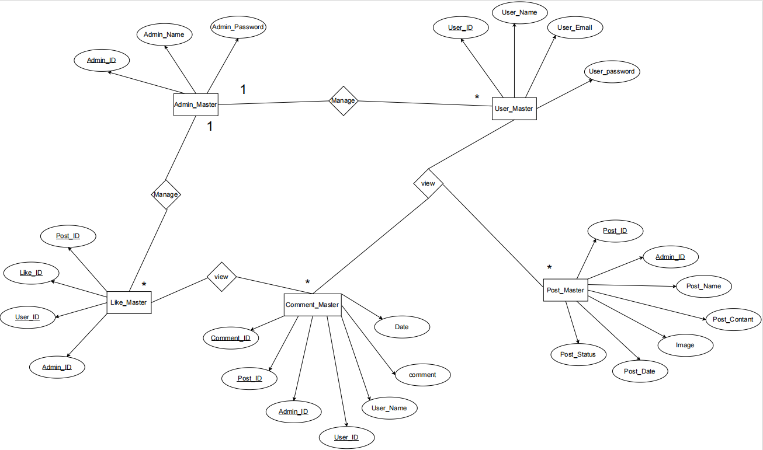
Diagram
ER Diagram

Slide 17
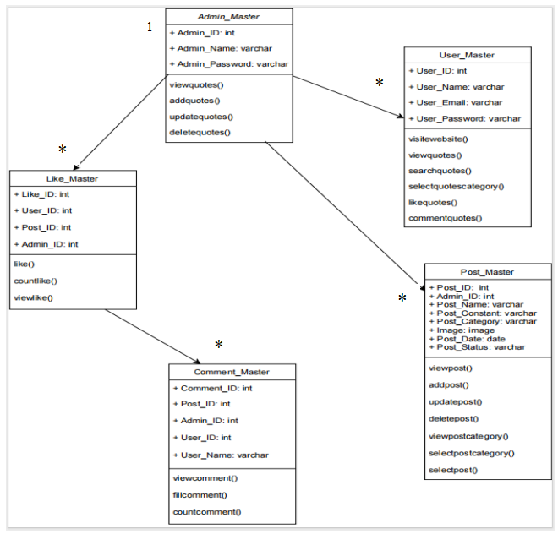
Diagrams
Class Diagram

Slide 18
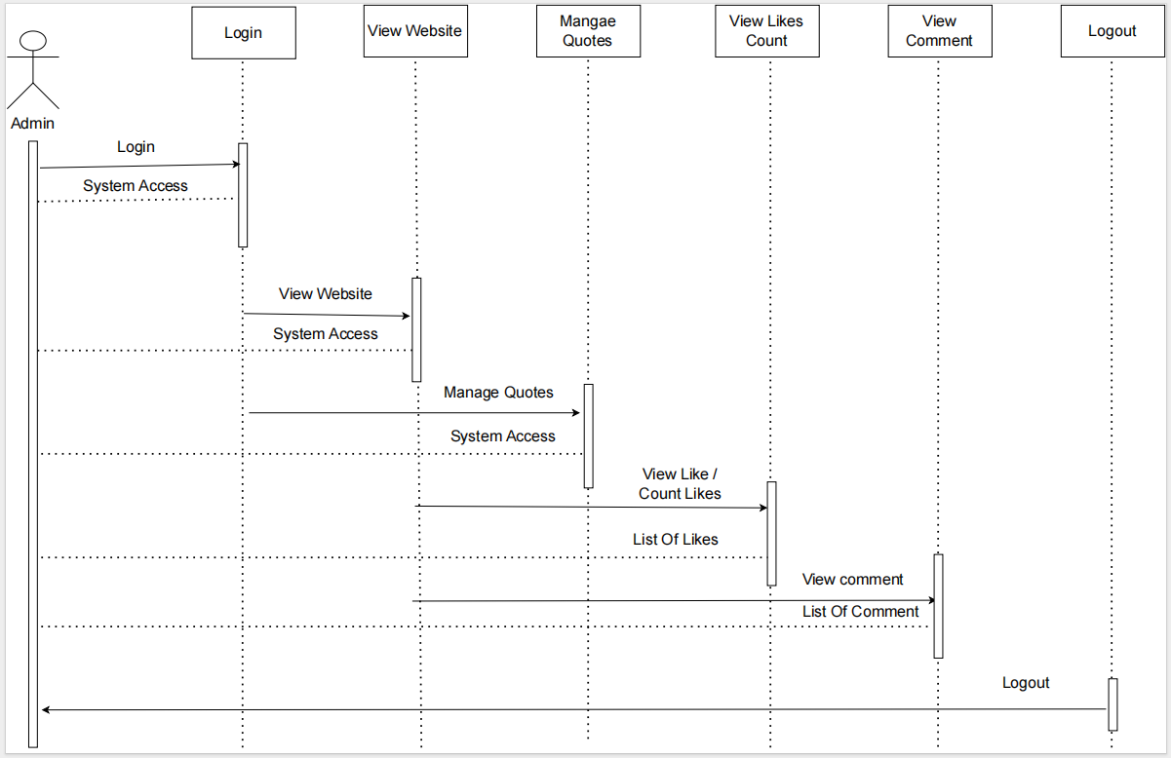
Diagrams
Sequence Diagram (Admin)

Slide 19
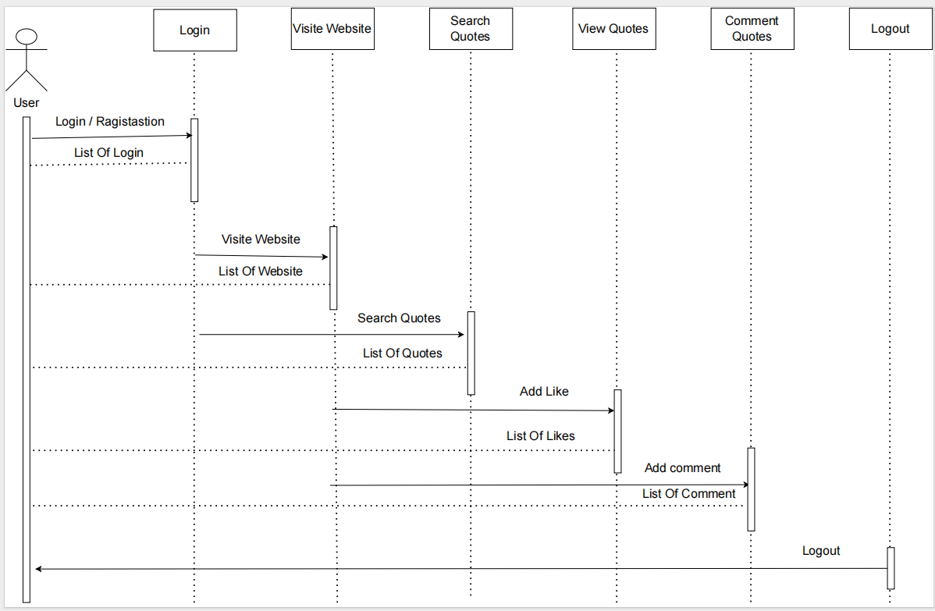
Diagrams
Sequence Diagram (User)

Slide 20
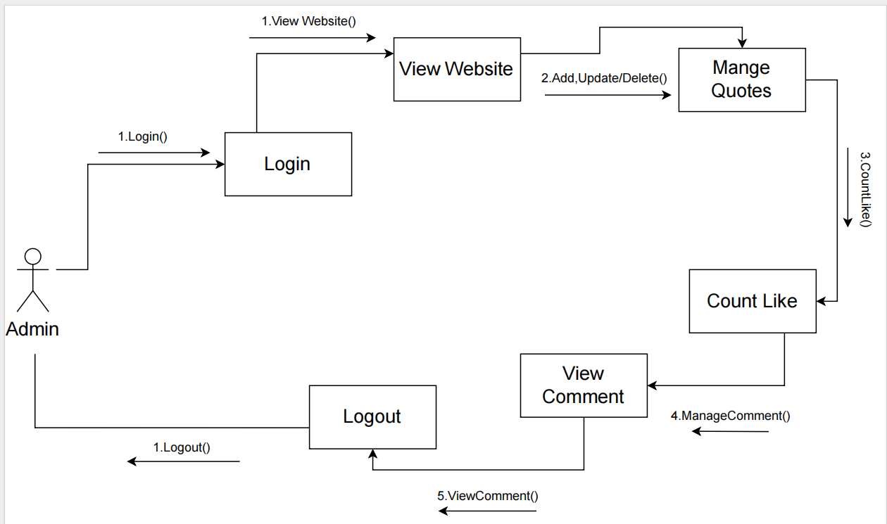
Diagrams
Collaboration Diagram(Admin)

Slide 21
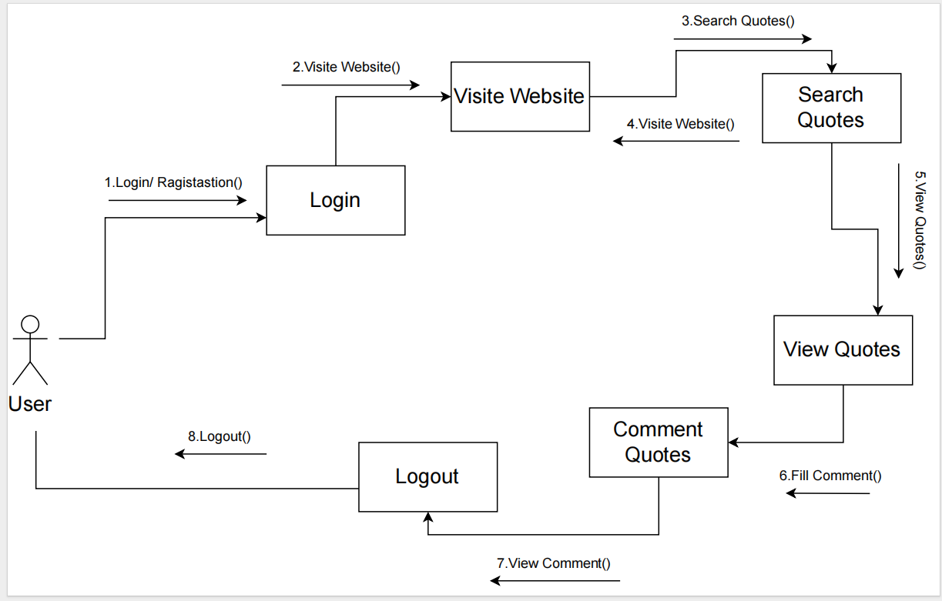
Diagrams
Collaboration Diagram(User)

Slide 22
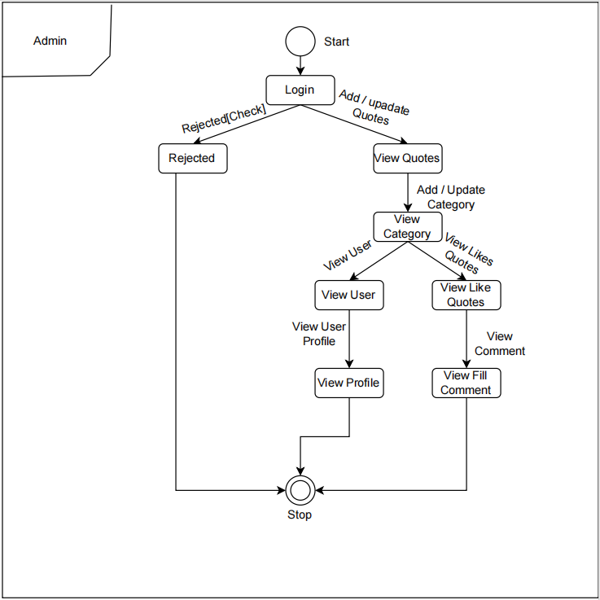
Diagrams
State Diagram (Admin)

Slide 23
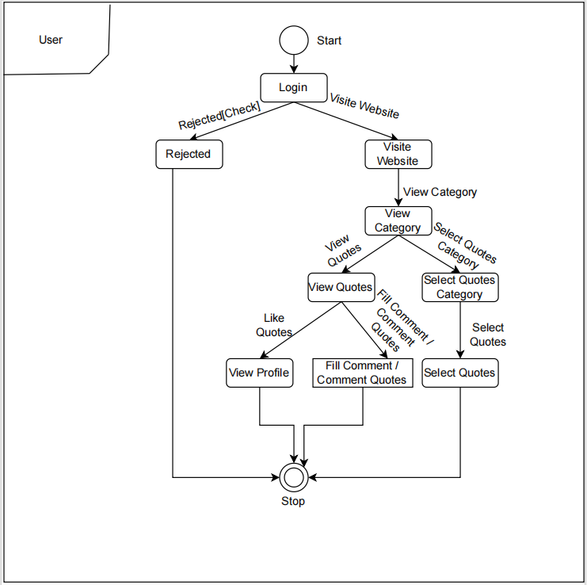
Diagrams
State Diagram (User)

Slide 24
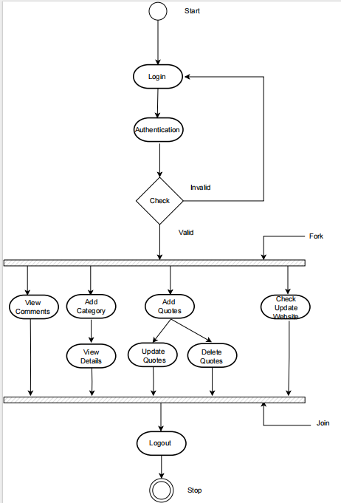
Diagrams
Activity Diagram (Admin Side)

Slide 25
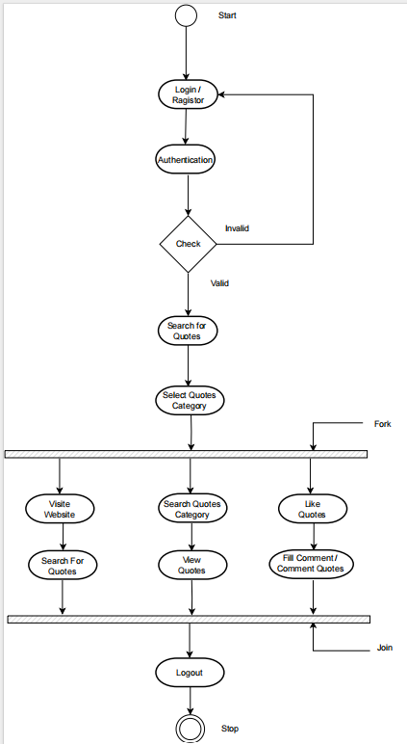
Diagrams
Activity Diagram (User Side)

Slide 26
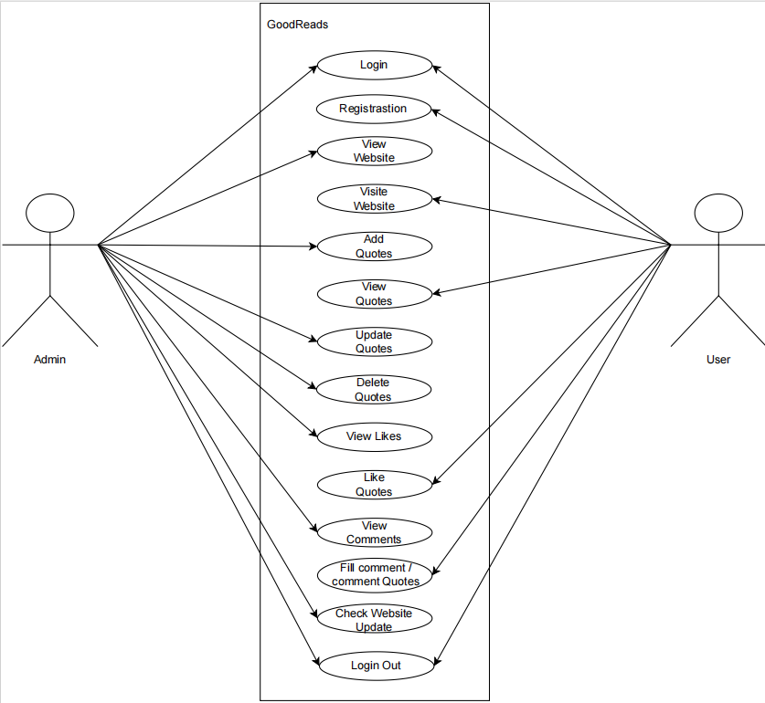
Diagrams
Use Case Diagram

Slide 27
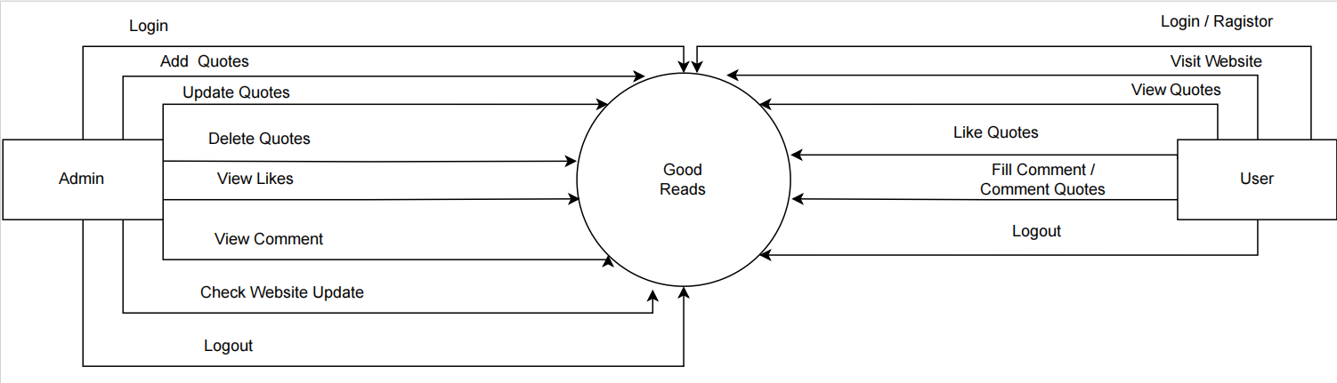
Diagrams
Data Flow Diagram (Level-0)

Slide 28
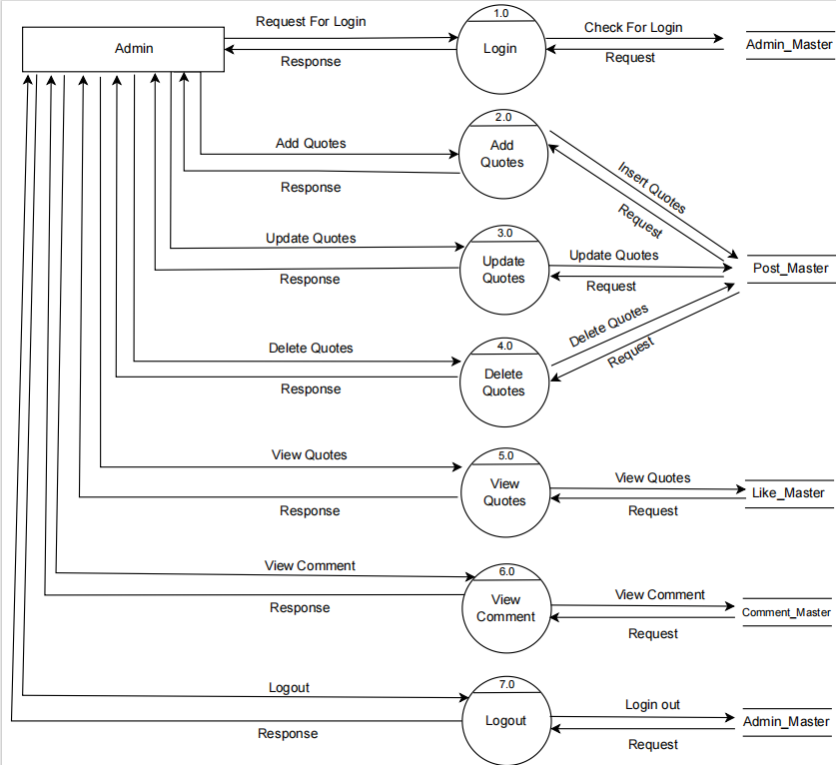
Diagrams
Data Flow Diagram (Level-1) (Admin Side)

Slide 29
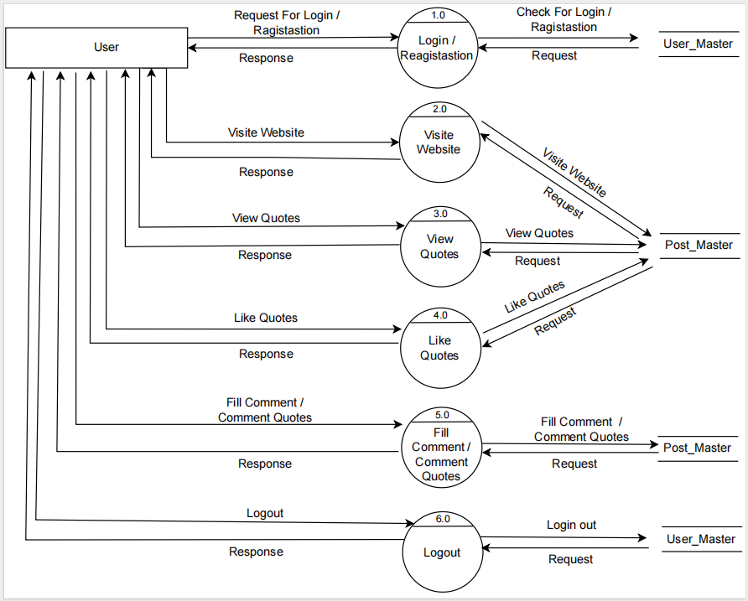
Diagrams
Data Flow Diagram (Level-1) (User Side)

Slide 30
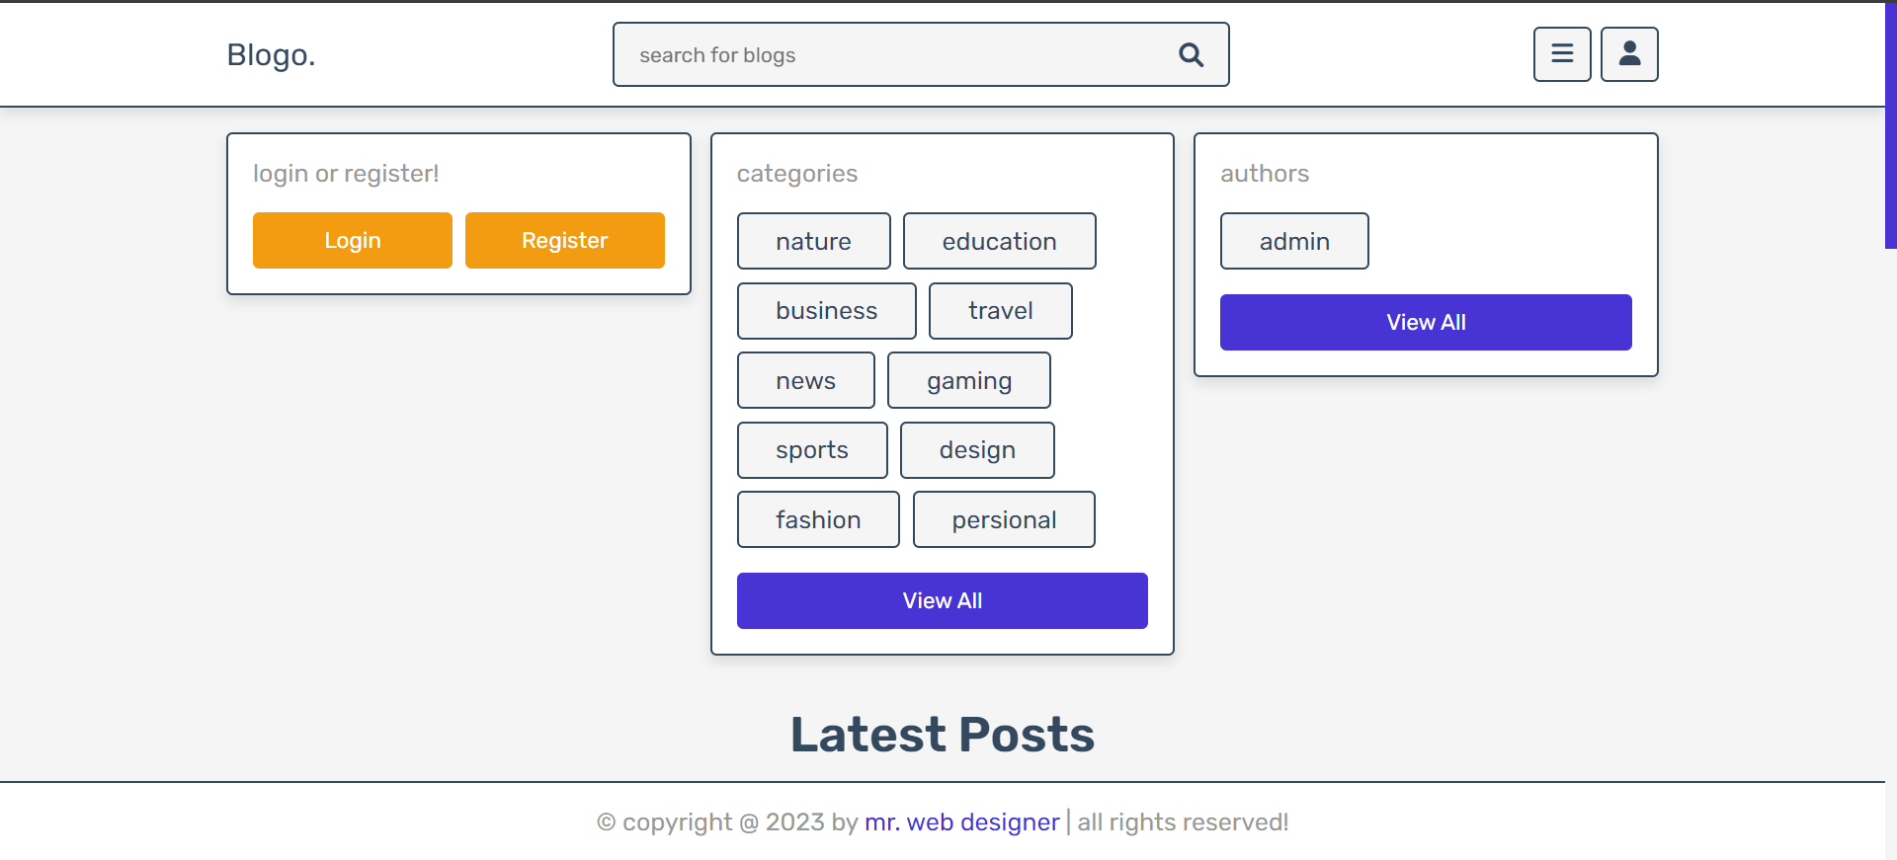
Screenshot
Home Page

Slide 31
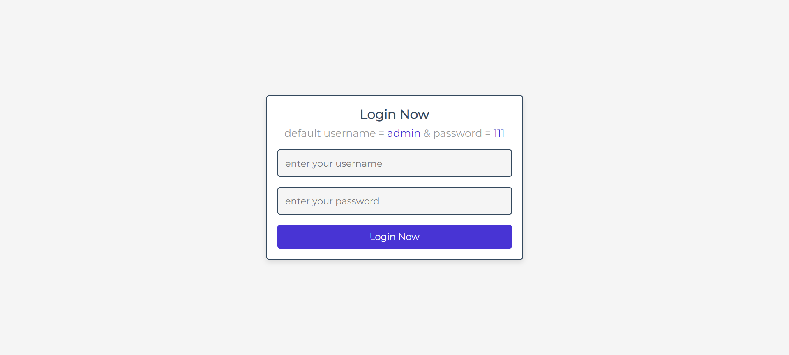
Screenshot
Admin Login

Slide 32
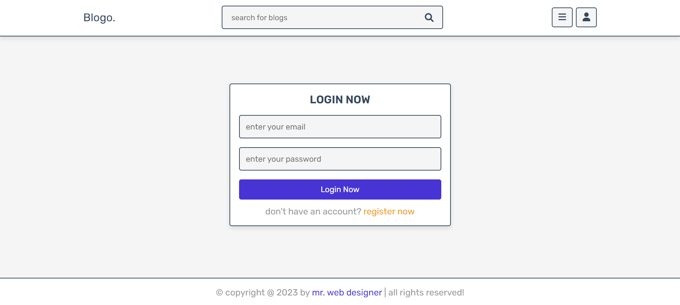
Screenshot
User Login Page

Slide 33
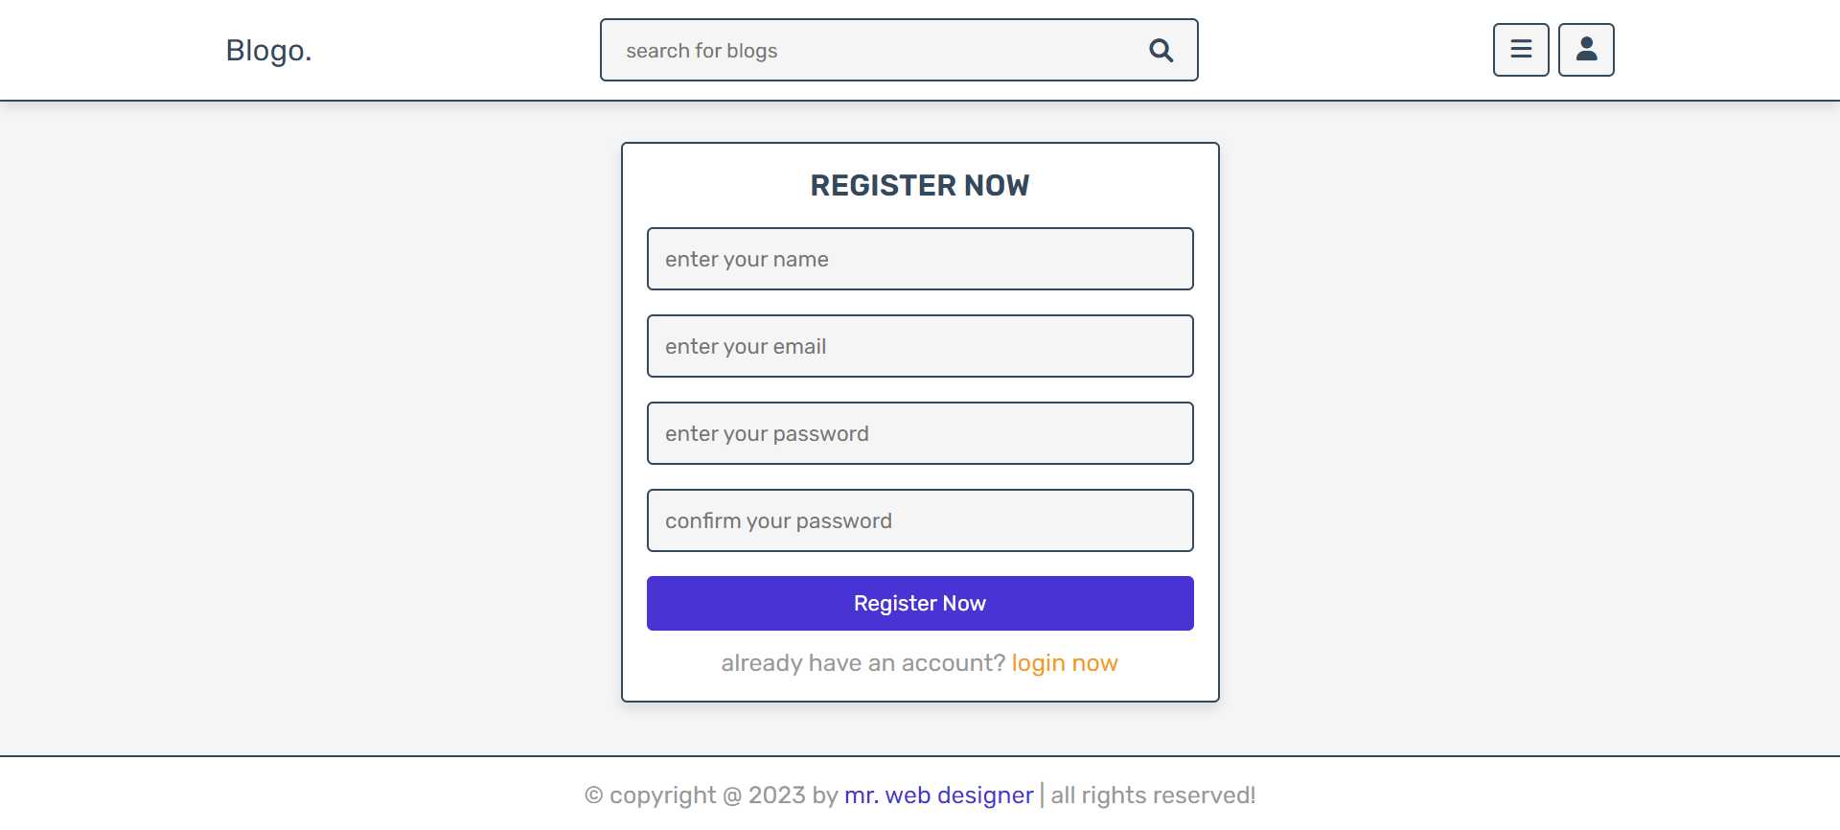
Screenshot
User Registration

Slide 34
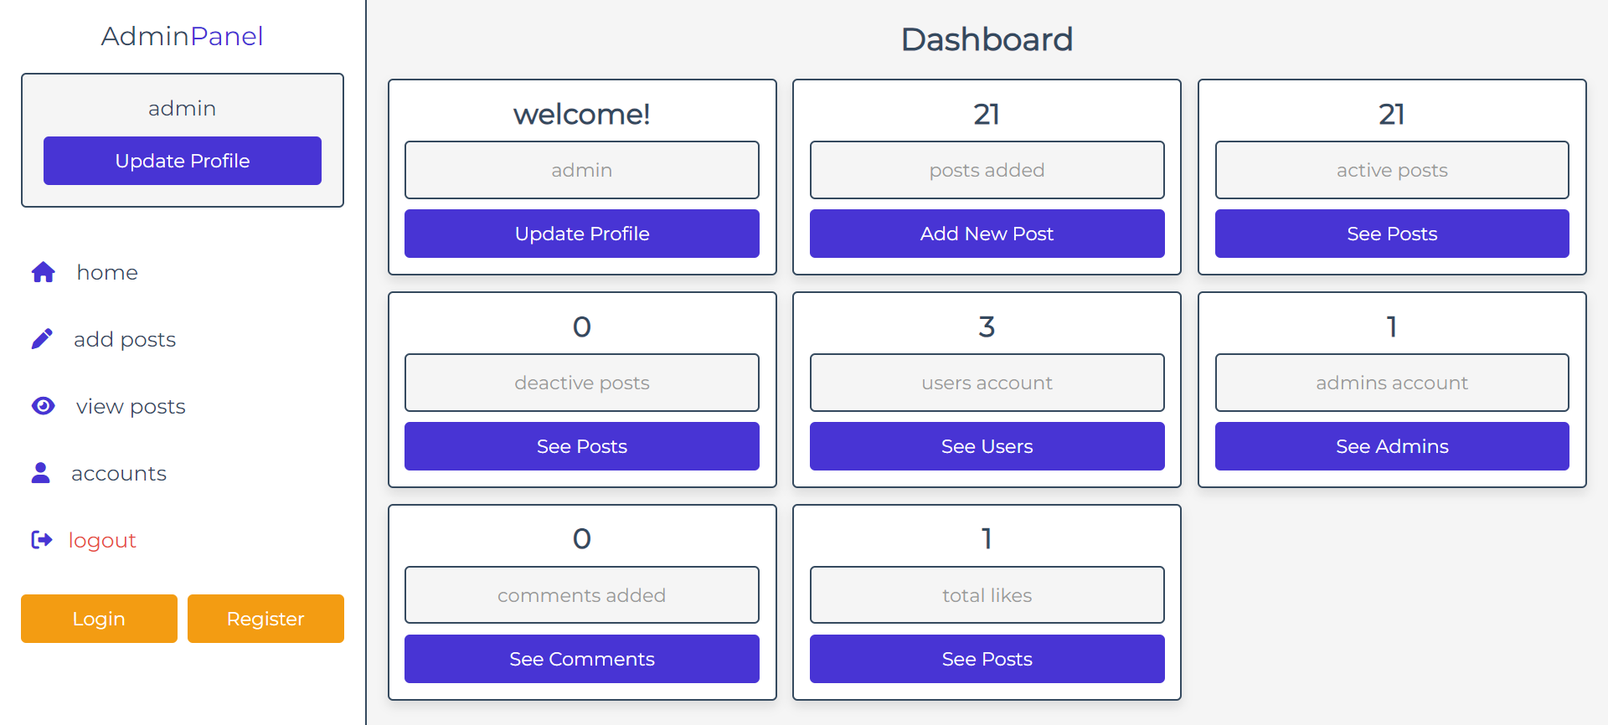
Screenshot
Admin Dashbord

Slide 35
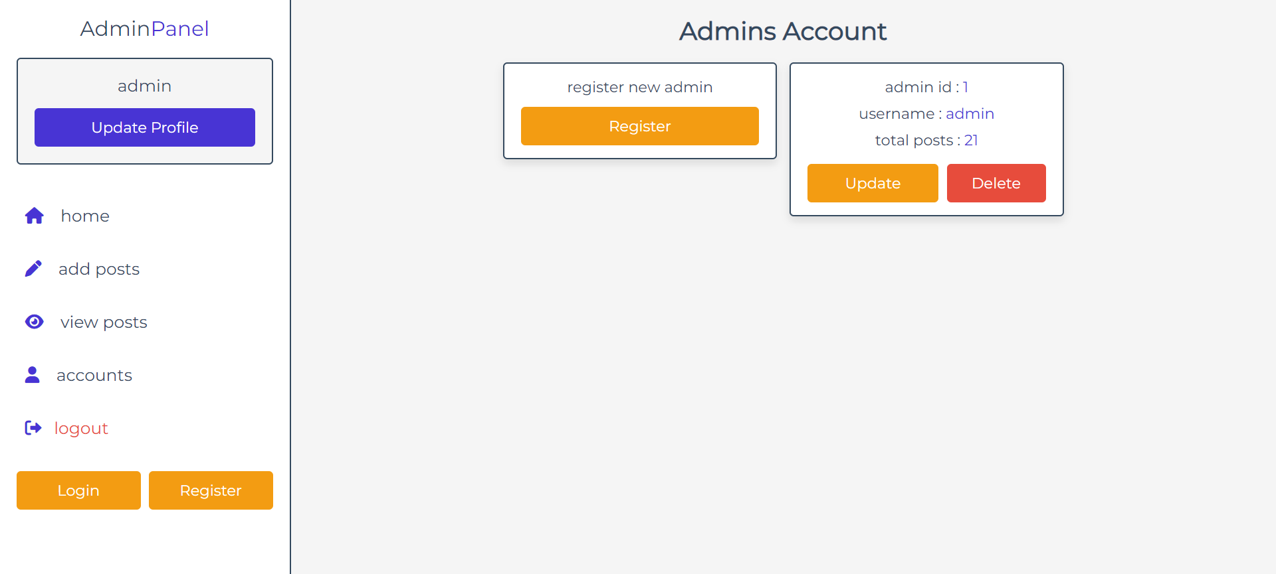
Screenshot
Admin Account Page

Slide 36
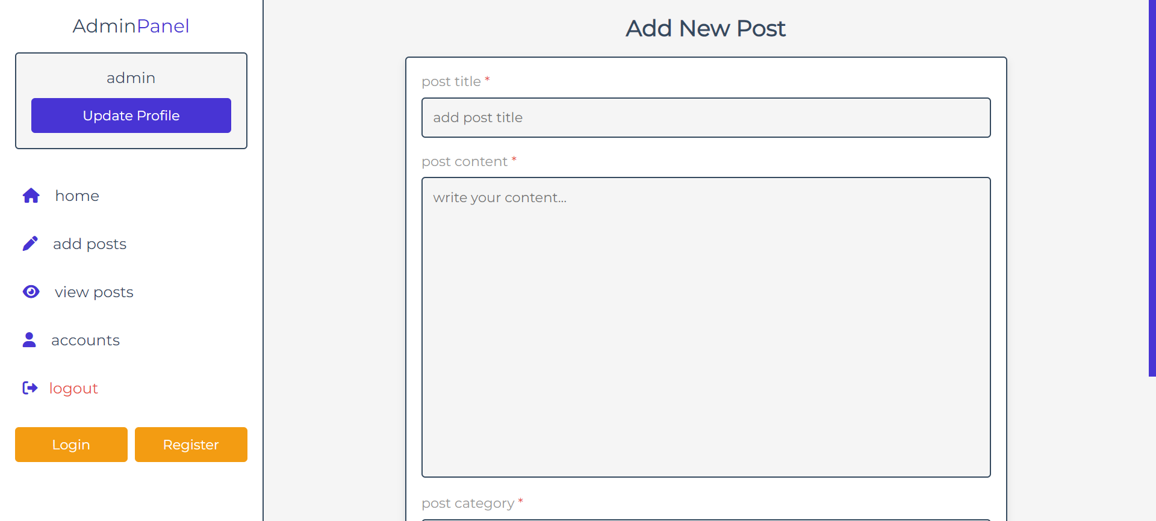
Screenshot
Admin add post page

Slide 37
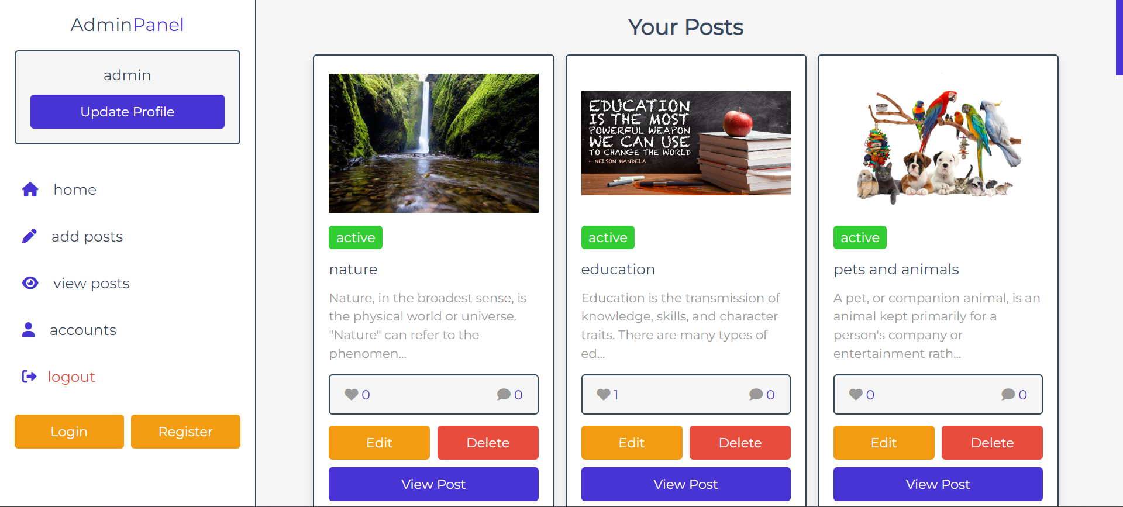
Screenshot
Admin update & delete post page

Slide 38
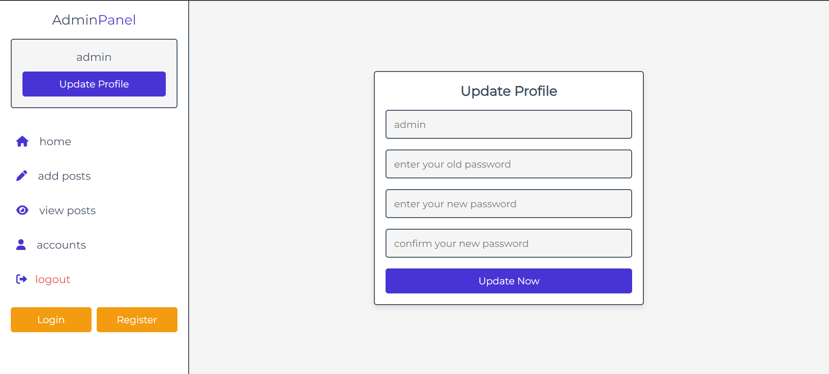
Screenshot
Admin update profile

Slide 39
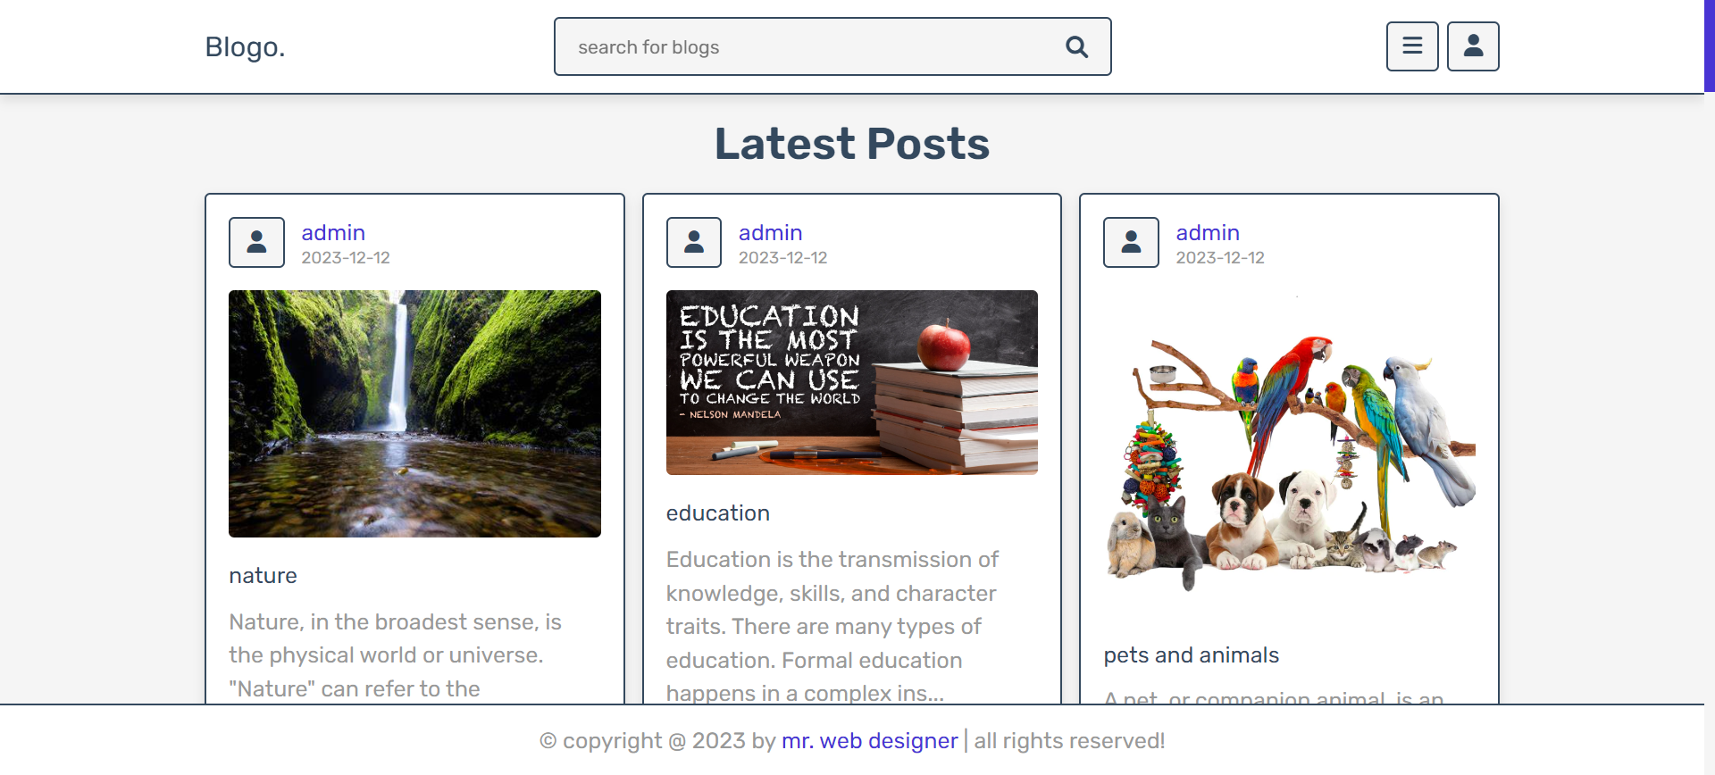
Screenshot
Post Page

Slide 40
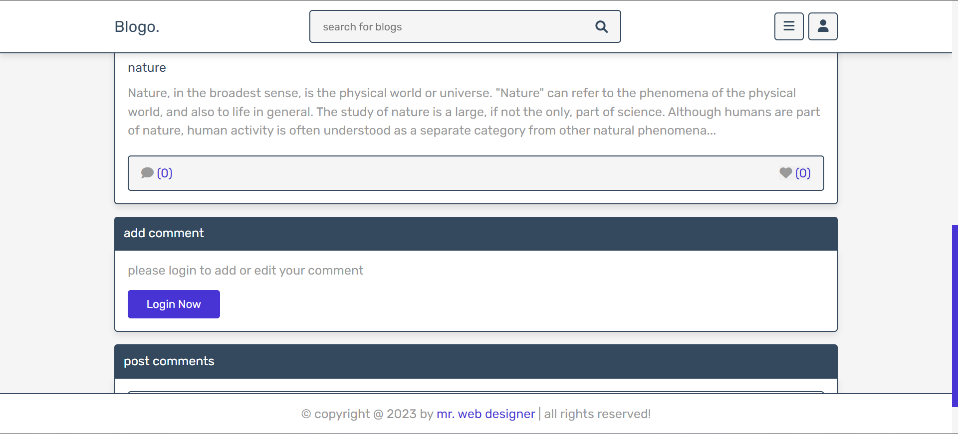
Screenshot
Search post & like & post comment

Slide 41
Screenshot
View Post Page

Slide 42
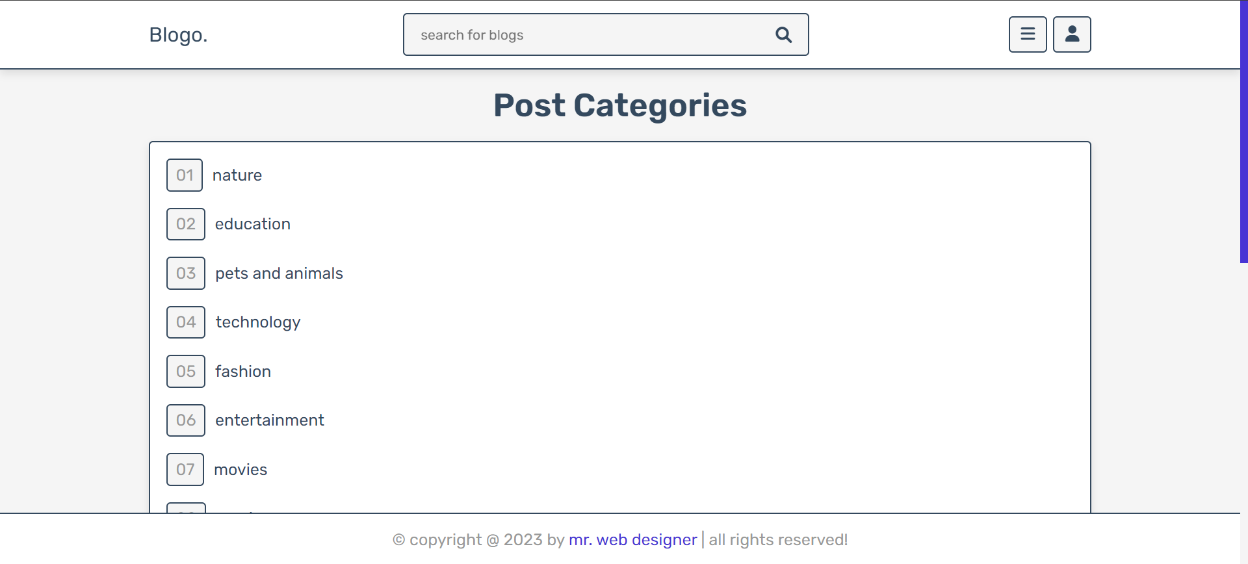
Screenshot
Post category page

Slide 43
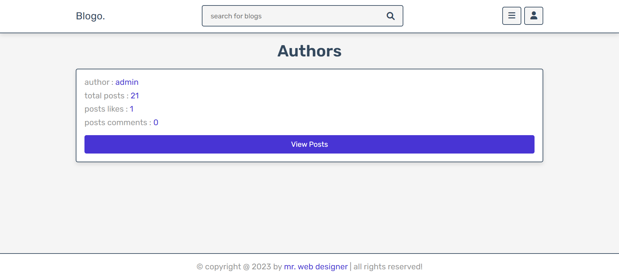
Screenshot
Author page

Slide 44
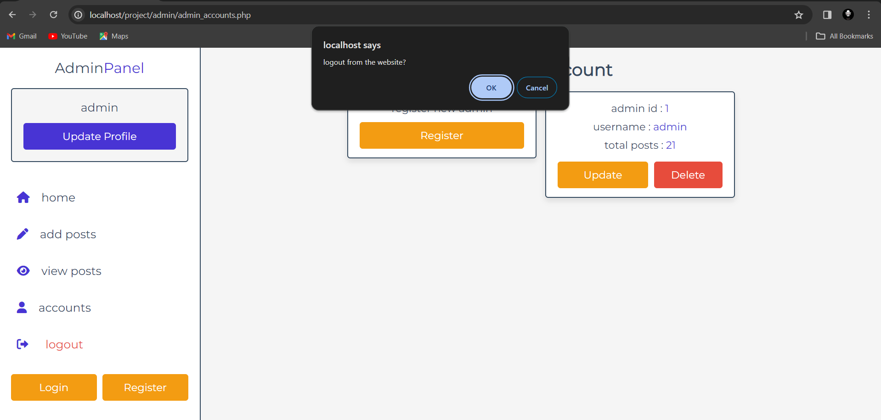
Screenshot
Admin logout page

Slide 45
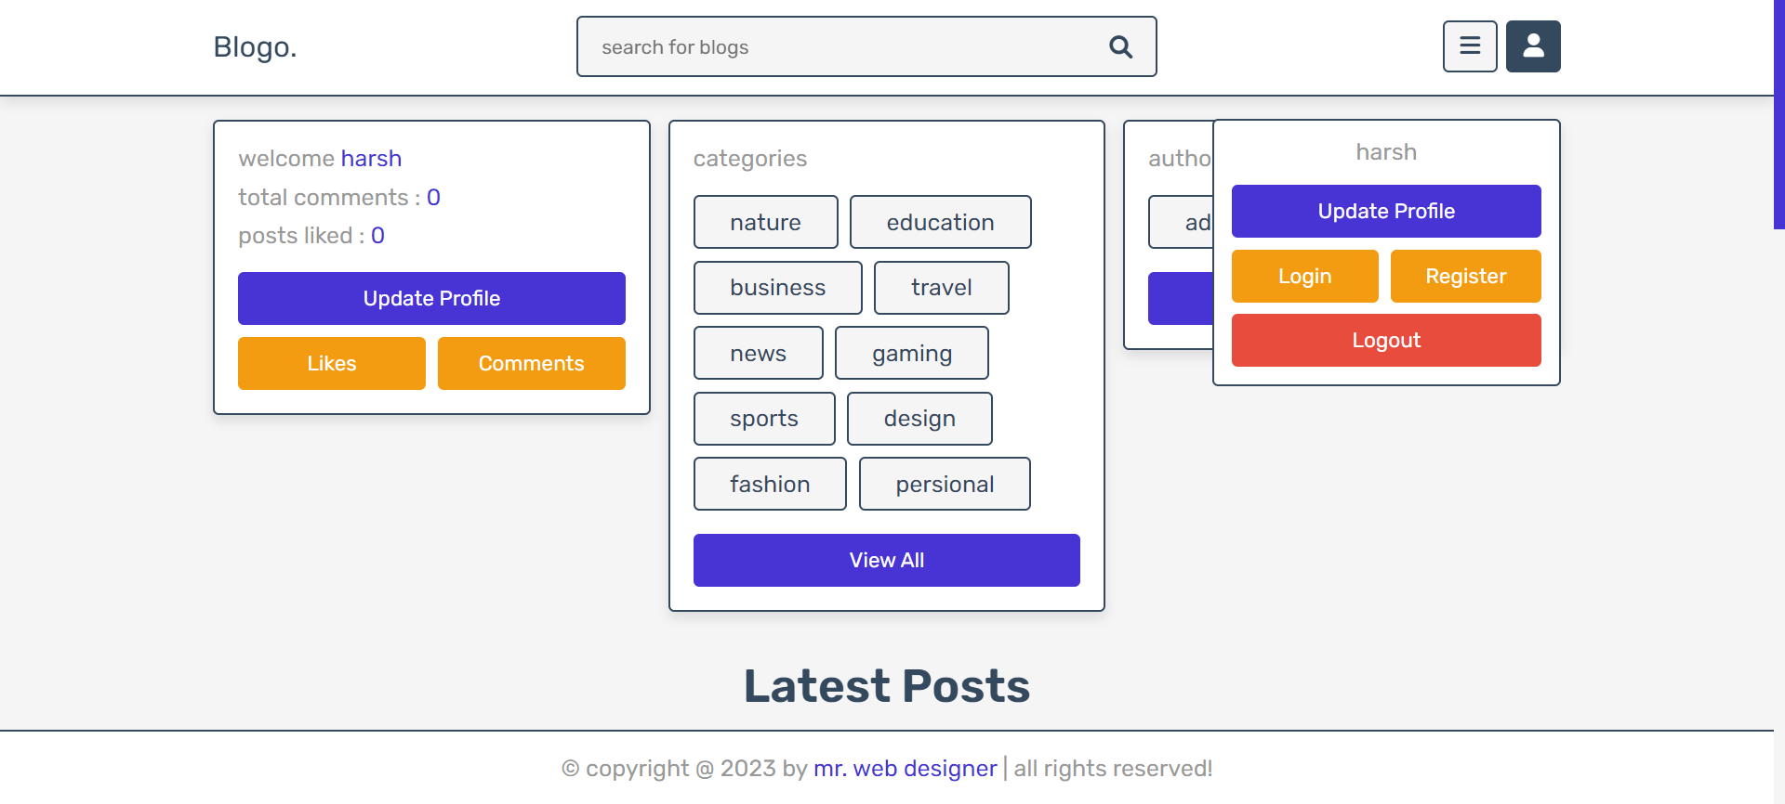
Screenshot
User update profile & logout page

Slide 46
Conclusion
The Good Reads Is the website to reads different types of the blog user can search related any topic and user can view the blog , user can read the blog , If user interest into the blog user can like and comment , user will login into the over blog website from admin side I login into the admin panel then I check for user login, user likes counts,user comment, add some new blog,update blog , delete blog,add team,edit team and admin will logout from the website.

Slide 47
Expected outcome
This Good Reads website of different types of quotes my future scope is user get some new thing to read the blogs , my spacial scope is user know about the new tournaments,cricket,news etc.. , user will look that quotes and know about any related topic understand knew about new quotes we make website easy to use the user.

Slide 48
THANK YOU…

